Slide 1
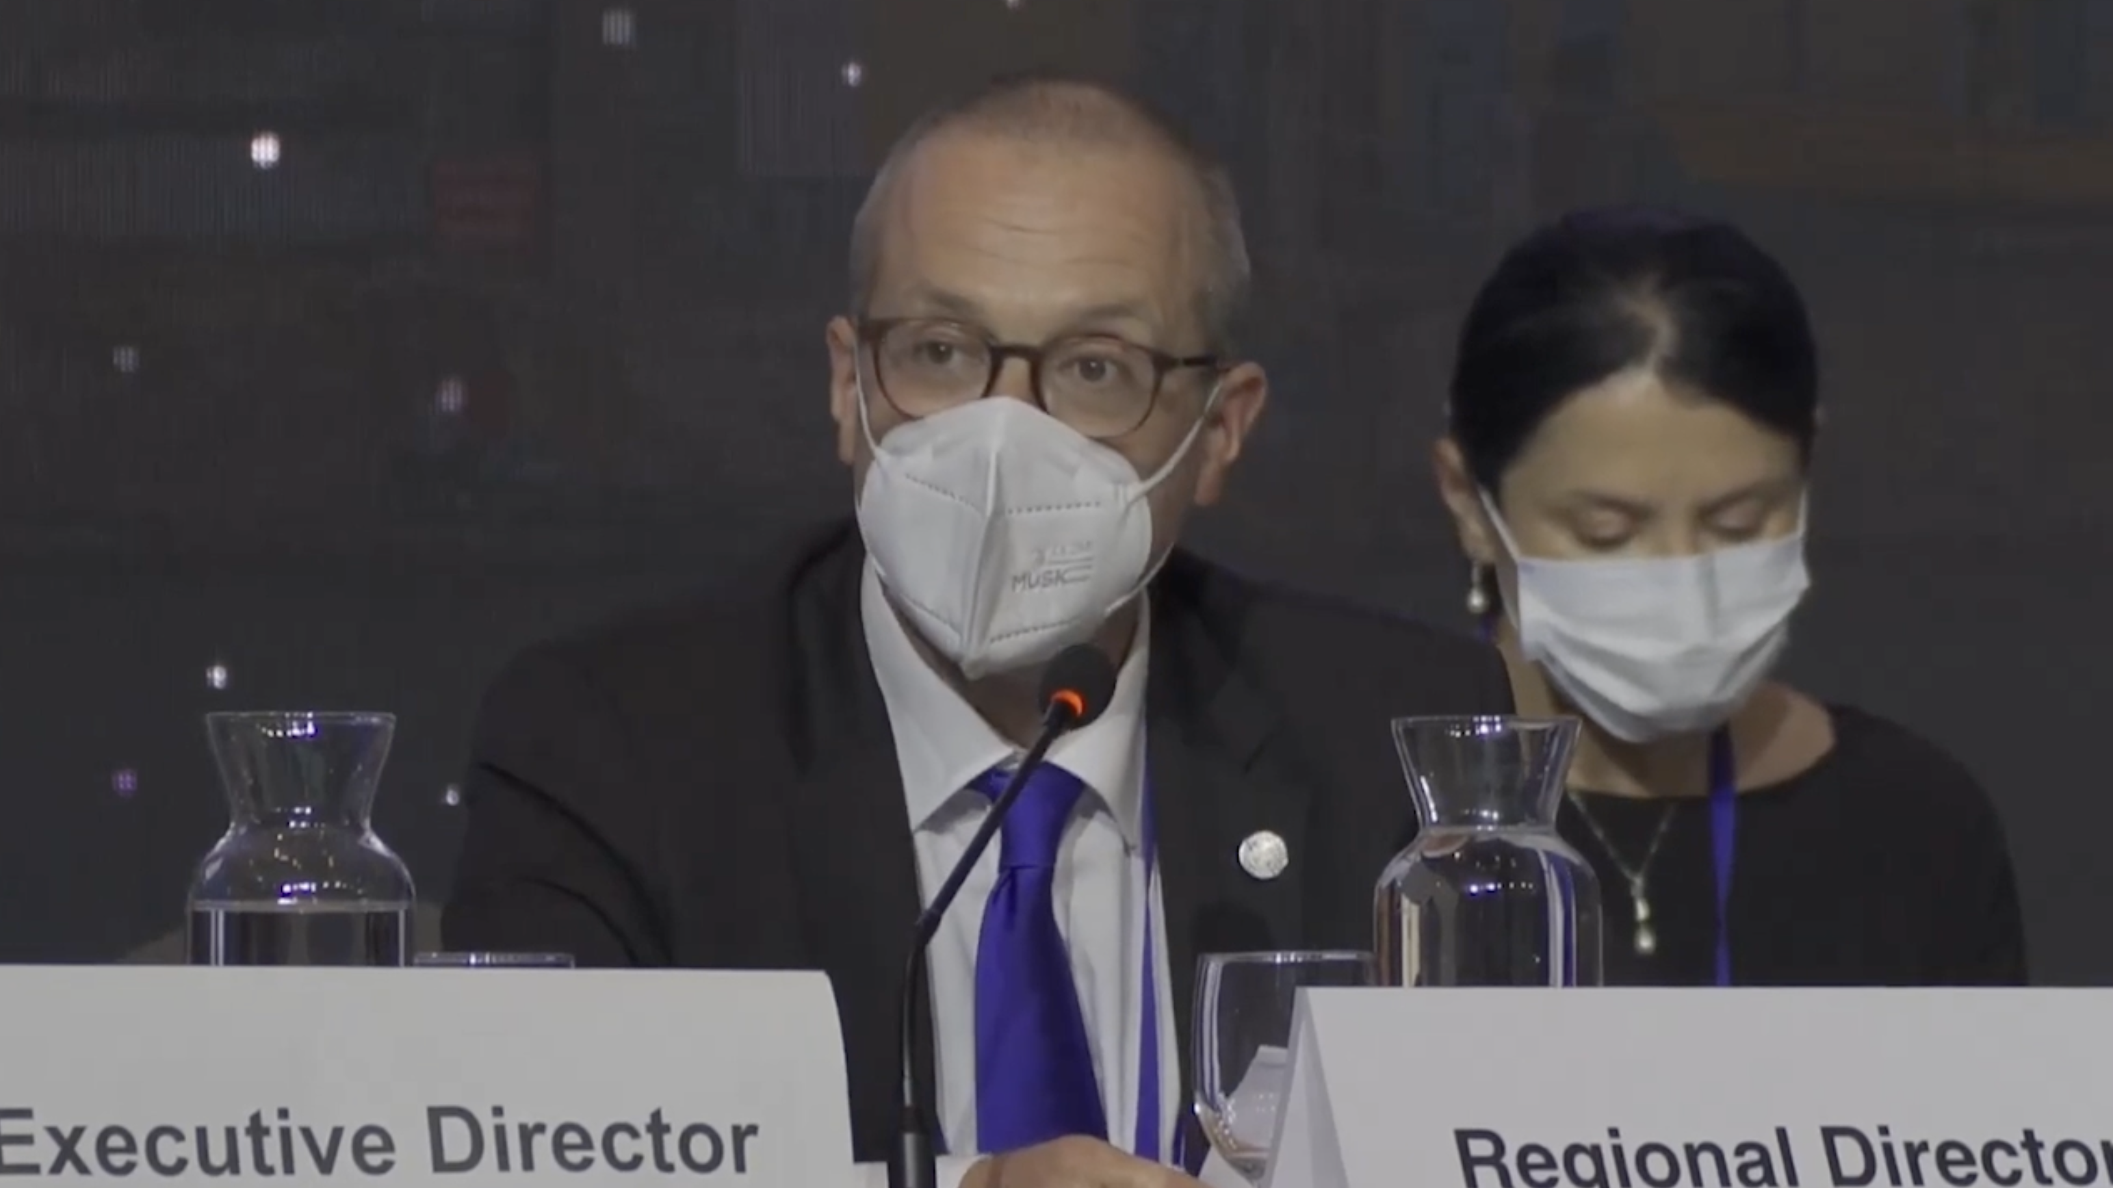



The ongoing journey to commitment and transformation Digital Health in the European Region
David Novillo Ortiz
Regional Adviser, Data, AI and Digital Health
Division of Country Health Policies and Systems
World Health Organization, regional office for Europe
dnovillo@who.int
@davidnovillo
Notes:
Intro 60 seconds video: you are busy people, let us give you a high-level summary
12 September 2023: Landmark moment for the 53MS of the EURO region, First ever DH action plan, our tool to operationalize the Global DH strategy.
Two of our commitments: promote dialogue; and to have a better understanding of the current situation and trend on DH. Today, we are delivering that commitment.
While far from perfect, it’s a starting point.

Slide 2







The Pillars of Transformation
Part 1 - The Leaders - National Digital Health Governance
Part 2 - The Lifelines - Electronic Health Records
Part 3 - Bridging Distances – Telehealth
Part 4 - Health In your Hands - Mobile Health and Health Apps
Part 5 - The Power of Knowledge - Big Data and Advanced Analytics for Health
Part 6 - Sharing is Caring - Access to and Sharing of Data
Notes:
Before moving to the content, let me talk about the methods:
53 MS replied (not all replied to all questions), period April-October 2022
Countries grouped by subregion according to the UN statistics office (country profiles will be published later this year)
It’s a data reach report with analysis from a questionnaire with 95 questions, 37 figures and 16 case examples.
Content: understand the evolution of digital health, identify barriers, and provide some recommendations.
Today: a high-level executive summary

Slide 3


The Leaders – National Digital Health Governance
Member States with policies or strategies addressing digital Health, universal health coverage and HISs, by subregion
(44 out of 53 countries) have a national digital health policy or strategy
83%
19%
(out of 39 countries) have developed guidance for evaluating digital health interventions
52%
(27 out of 52 countries) have developed policies and strategies for digital health literacy
Notes:
Intro: Central to our journey in digital health and digital transformation is a strong and clear leadership. National Digital Health Governance plays this role by setting standards, guidelines, and the strategic direction for the health sector's digital future.
83% MS have national DH policies/strategies – CAR and Northern Europe stand out.
19 countries have developed guidance for evaluating DH interventions. –We need assessment mechanisms that analyze the clinical and the cost effectiveness of DH practices.
52% of MS have DHL policies and/or strategies. –We need and extra effort to effectively engage with DH solutions and make informed health care decisions, --It’s essential to incorporate DHL into national health objectives.
Relevant sessions: Ministerial panel; Governance tomorrow at 9:15
Transition: After this quick snapshot on the digital health governance in the region, the question now is what are the pivotal tools driving digital health transformation? Let's delve into the heart and lifelines of digital healthcare: Electronic Health Records, or EHRs.

Slide 4

The Lifelines - Electronic Health Records
EHR implementations and EHR legislation by subregion
91%
(48 out of 53 countries) have legislation supporting the use of their NEHR
(45 out of 52 countries) have either a national EHR system (NEHR), interconnected regional EHRs, or a patient portal
87%
Notes:
* Intro: EHRs are the heartbeat of modern medical care, capturing and preserving every crucial detail of patient history and treatment.
91% MS have the necessary legal framework to support the use of their EHR.
87% MS can collect/share patient information through a national EHR, interconnected regional EHRs or a patient portal.
This number has increased from 36 to 45 MS from 2015.
Northern Europe is the more decentralized, aveit connected system.
Southern Europe reports exclusively NEHR.
Central and Western Asian report the most significant number of barriers (funding/infrastructure)

Slide 5
The Lifelines - Electronic Health Records
86%
(42 out of 49 countries) reported that patient information was shared from EHRs in primary practice with other health professionals either routinely or occasionally
Standards used to support NEHR systems
Notes:
86% MS share patient information in primary practice through EHR with other health professionals.
And to facilitate this sharing, standards such as ICD, DICOM and HL7 are the most prevalent standards adopted by MS.
We can also see an increase of SNOMED CT in all regions with the exception of eastern and southern Europe.
Barriers: funding; capacity or trained human resources.
Recommendations: roadmap for full implementation of health data standards and address interoperability at local/regional level to facilitate integrated HIS.
More patient-centred approach to meet patient needs.
Relevant sessions: Engage. Empower. Engage. Repeat (first day, afternoon)
Transition: but while data is being recorded, how do we extend healthcare beyond traditional walls? This leads us to our next point: Bridging Distances through Telehealth.

Slide 6

Bridging Distances - Telehealth
78%
(40 out of 51 countries) directly address telehealth in their policies or strategies
Maturity of Telehealth Initiatives in 2015 and 2022
(30 out of 51 countries) introduced a new law, legislation, or policy to support telehealth during the COVID-19 pandemic
59%
37%
(16 out of 43 countries) reported that a telehealth service in their country had been evaluated
Notes:
Intro: Telehealth brings healthcare closer to those who, due to a geographic or physical constraints, found it out of reach
78% MS address telehealth in their policies/strategies (there is an increase of 12 more MS since 2015).
59% introduced new legislation/policy to support telehealth directy COVID.
37% reported that a telehealth service had been evaluated. Long way to go, but an increase of 6 MS from 2015.
Figure: the biggest relative growth has been in telemedicine and telepsychiatry, partly attributed to the disruption of care during COVID.
We need more systematic monitoring and evaluation:
How to contribute to national health related objectives.
Demonstrate benefits for patients in access and outcomes.
Relevant session: telehealth session (tomorrow afternoon)
Transition: With medical consultations possible from the comfort of one's home, how can we further empower individuals? Let's explore how healthcare is literally moving into your hands with mHealth and mobile applications.

Slide 7

Health in your hands – Mobile health and Health Apps
Most common types of mHealth programmes and
services for health care
(31 out of 46 countries) have mHealth services providing access to a EHR that were reported as established
67%
0%
(6 out of 39 countries ) had evaluated any mHealth service or programme
64%
(34 out of 53 countries) had introduced applications to carry out contact-tracing
Notes:
Intro: mHealth harnesses the power of smart phones to revolutionize healthcare, promoting real-time access, personal engagement, and efficient remote care services. More mobile devices than people.
67% MS have mhealth services established to provide access to EHR.
15% had evaluated a mHealth service, but evaluation should become the norm rather than the exception,
When asking for mHealth applications during the pandemic, the most popular application was related to contact tracing (64%)
Barriers: privacy and security; lack of patient digital literacy
Relevant session: parallel sessions “It’s all about health” (tomorrow morning)
Transition: As these digital health technologies generate vast amounts of data every second, the question then becomes: How this data is being used to enhance patient experiences and inform public health decisions? We're about to delve into the Power of Knowledge, enabled by Big Data and Advanced Analytics in Healthcare

Slide 8


The Power of Knowledge - Big Data and Advanced Analytics for Health
Share of Member States that report infrastructure, services, tools, and applications to facilitate the use of varying advanced technologies
(30 out of 50 countries) report having developed an overarching national data strategy regulating the use of big data and advanced analytics in the health sector
60%
(17 out of 48 countries) stated that they had a national policy on the use of big data and advanced analytics in the health sector
35%
Notes:
Intro: Through Big Data and Advanced Analytics, we unlock insights, predict health trends, and optimize care like never before.
60% MS have developed an overarching national data strategy regulating the use of big data and advances analytics in the health sector, including AI.
35% MS have a specific national policy on the use of big data and advances analytics in the health sector.
Figure: the priorities, when about advanced analytics are related to artificial intelligence, cloud computing and personalized medicine.
Barriers: lack of different data formats; lack of integration; privacy and security.
Recommendations: develop national data policy/strategy for the use of advanced analytics; evaluate and regulate algorithms and products using algorithms to prevent adverse outcomes.
Relevant sessions: AI session this morning, and another session on big data tomorrow afternoon.
Transition: Utilizing the full potential of Big Data ana analytics necessitates open channels for data sharing, making collaboration not just beneficial, but essential. This brings us to our last but incredibly crucial point: 'Sharing is Caring: Access to and Sharing of Data.

Slide 9


Sharing is caring - Access to and sharing of Data
100%
All Member States have passed privacy legislation
(48 out of 53 countries) report having legislation to protect the privacy of an individual’ s health-related data in electronic format in an HER
(44 out of 51 countries) have legislation that allows individuals electronic access to their own health data in their EHRs
Patient access to and control of data
91%
89%
Notes:
Intro: By ensuring data accessibility and fostering a culture of data sharing, we pave the way for collaborative health solutions, research, and global progress in healthcare.
All MS have passed privacy legislation.
91% report having legislation to protect the privacy of an individual in electronic format
89% have legislation that allows individuals electronic access to their own health data in their EHRs
We have observed that an online portal is a common mode of access in a number of countries.
Transition: The future of healthcare isn't just digital; it's interconnected, making each of us not just consumers but contributors to a global well-being. Together, we don't just navigate change; we become the architects of a new, health-empowered world.

Slide 10


The way forward
Develop robust evaluation guidelines and increase digital health literacy
Ensure sustainable financing and collaboration
Address interoperability and standardize health data
Promote patient-centered care and digital inclusion
Establish Effective Governance

Slide 11

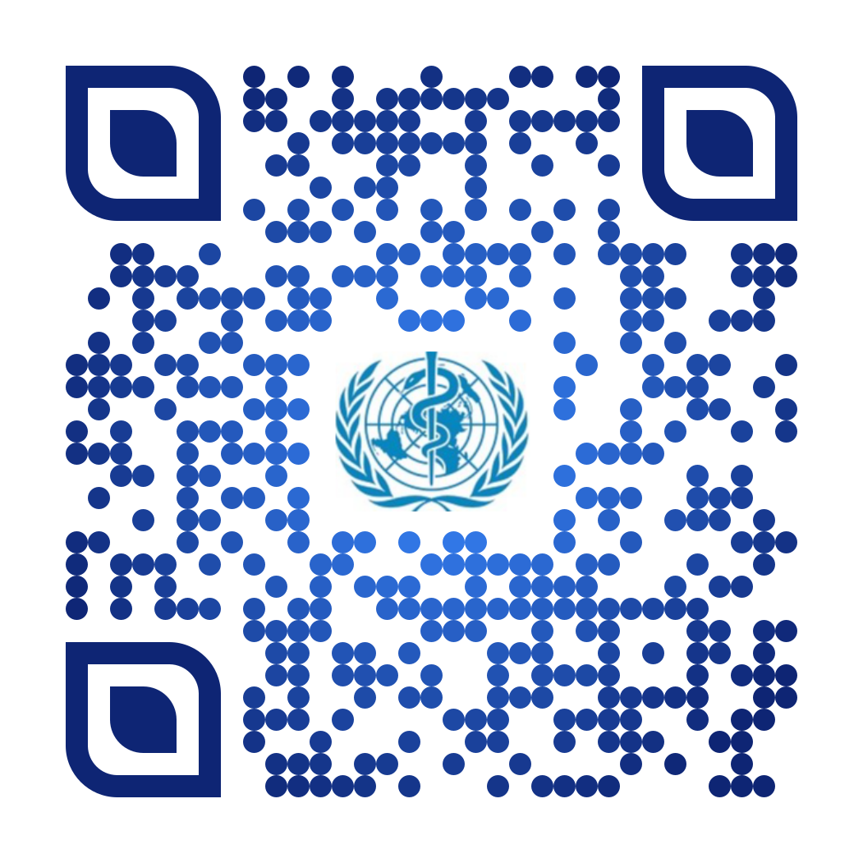
The ongoing journey to commitment and transformation Digital Health in the European Region
Thank you
Notes:
Thank you the Elettra, Keyrellous, the authors and the MS for responding to our request.

