Slide 1
Remaining relevant in a rapidly changing healthcare landscape
Perspectives from HIQA - the Irish Health and Social Care Systems Regulator
Sean Egan, Director of Healthcare Regulation HIQA
ERS Conference, Porto, Portugal - 23 October 2025

Slide 2
HIQA is an independent statutory authority, established in 2007, to improve the safety and quality of health and social care services in Ireland
Standards - We develop person-centred standards and guidance for health and social care services
Regulation - We regulate residential services for older people, people with a disability and children’s special care units, as well as medical exposure to ionising radiation
Monitoring - We monitor the quality and safety of health services, International Protection accommodation services and children’s social services
More recently – we have been asked to become the Competent Authority for the Healthcare Sector under the Critical Entities Resilience Directive, and have been asked to consider a similar role under NIS2 (Cybersecurity)
Health Technology Assessment - We evaluate the clinical and cost-effectiveness of health programmes, policies, medicines, medical equipment, diagnostic and surgical techniques, and health promotion and protection activities
Health Information - We aim to develop a consistent and standardised approach to health and social care information use, including in National Data Collections and eHealth services in Ireland
Care Experience Surveys -
We also carry out service-user experience surveys, including the National Inpatient Experience Survey

Slide 3
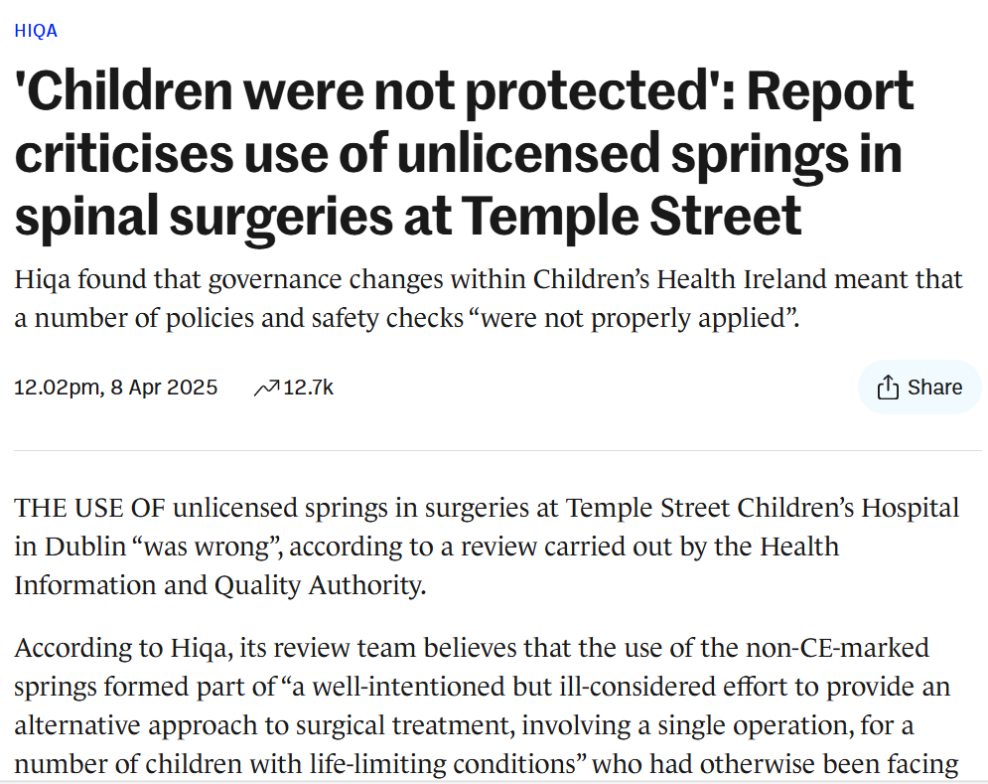
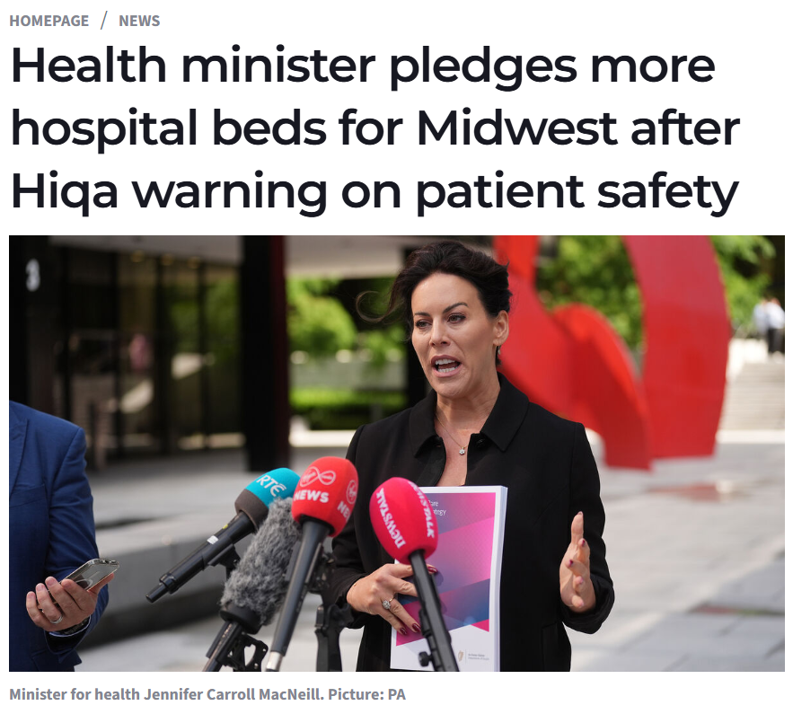
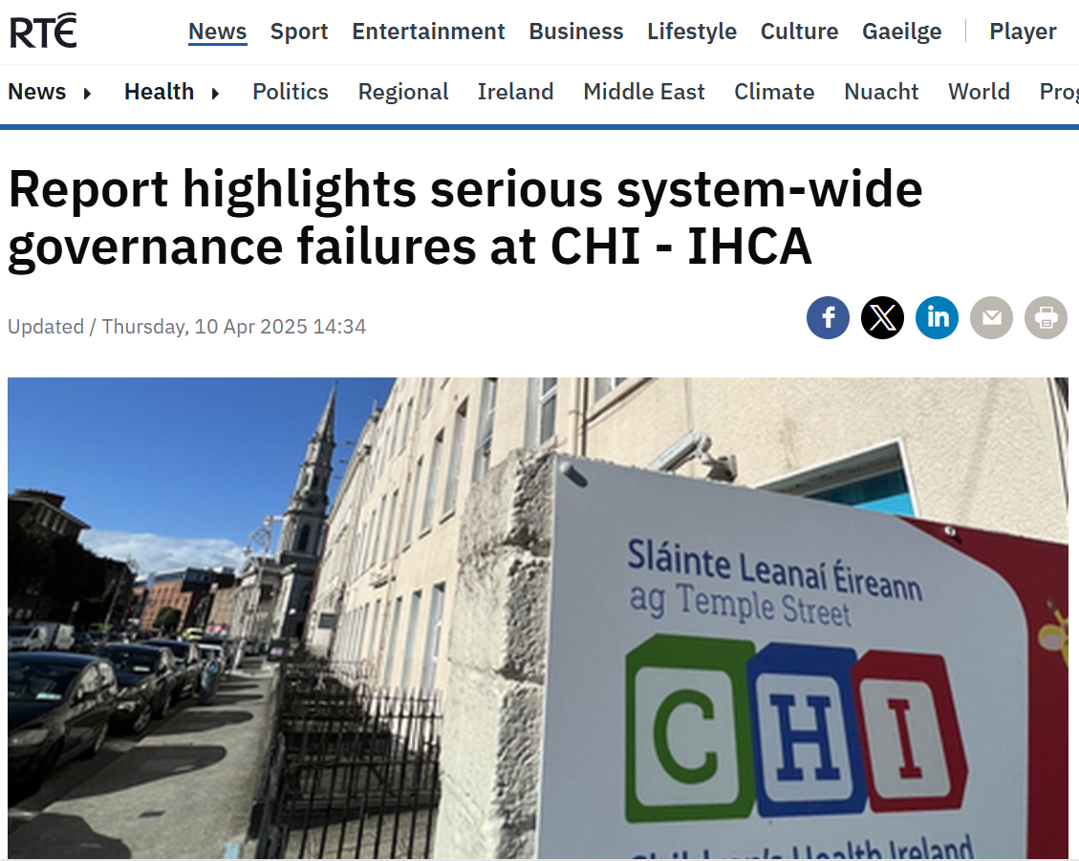
Recent examples of key work we have done in healthcare monitoring and regulation
Review on governance of implantable medical devices at CHI, including use of non-CE marked springs in surgery at CHI at Temple Street Available to read here
Advice to the Minister for Health to inform decision-making around the design and delivery of urgent and emergency healthcare services in the HSE Mid West region of Ireland Available to read here

Slide 4
The world we have come from – the evolution of conventional patient safety science since 1999’s “To Err is Human”
Error in healthcare recognised as a leading cause of patient harm
Identification that in addition to ensuring that all staff are properly qualified, trained, and operate to acceptable professional standards (the domain of Healthcare Professional Regulators), patient safety can only be safeguarded if the “system of care” within which these individuals work is also correctly designed, resourced and organised to promote safety
Taking a lead from other industries, focusing on error as a means of potential learning – with the aim to improve reliability and safety in health services (Safety 1)
Recognising that health services are a complex sociotechnical environment which make them different from other “higher risk” industries, and which therefore require more nuance in the promotion of safety (Safety 2)
Recognition of the critical role for good system planning, and effective leadership, governance and management to promote safe and effective care – with a role for Healthcare Systems Regulators such as HIQA to provide independent scrutiny of services

Slide 5
An evolving world, and finding our place within it
Familiar challenges – that are growing in magnitude
Healthcare staffing deficits
Population demographics – growing, aging populations
Increasing chronic disease – and a desire to try and provide more healthcare in lower complexity settings
The mismatch between healthcare innovation, public expectations around availability, and the ability for health systems to pay
Newer additional challenges that also need to be navigated
Use of AI
Geopolitical risks – and associated security requirements and economic impacts
Cybersecurity
Migration
The growing impact of climate change

Slide 6
How might this changing world impact upon healthcare systems regulators?
Management of the nexus of issues outlined requires a strong approach from a policy perspective – big problems require big solutions
European legislation is driving change in a number of key areas of change – CER, NIS2, AI - with Healthcare being a key sector
Using pre-existing healthcare systems regulators to provide subject matter expertise in realizing the regulatory aim of these areas of legislation in the health setting has merit given our sectoral experience
The EU AI Act – Important early legislation in this field – especially in applying protections against introduction of unsafe technologies – less clear in how it will fully promote system safety in the complex sociotechnical environment of healthcare – working to ensure proper governance in health systems beyond what the AI Act requires is key
All of these areas are “Non-traditional” for individuals and agencies who emerged from the Patient Safety Science expansion of the early 2000’s – Do we embrace these new potential roles or wait for others – who may not understand the healthcare context?

Slide 7
How might we add value in this new world?
We have experience in the objective and independent evaluation of healthcare systems safety and performance
We are a trusted voice, and have a competence in both system surveillance, and communication on performance
These new areas of risk are not independent of those areas of focus we already assess – indeed they are or will become core parts of healthcare delivery

Slide 8
Demonstrating our value – some reflections on moving beyond regulatory compliance levels

Slide 9
Demonstrating our value – some reflections on moving beyond regulatory compliance levels

Slide 10
Thank you

