Slide 1
Future challenges in regulation
Einar Hovlid
Director Norwegian Board of Health Supervision Professor Western Norway University of Applied Sciences

Slide 2
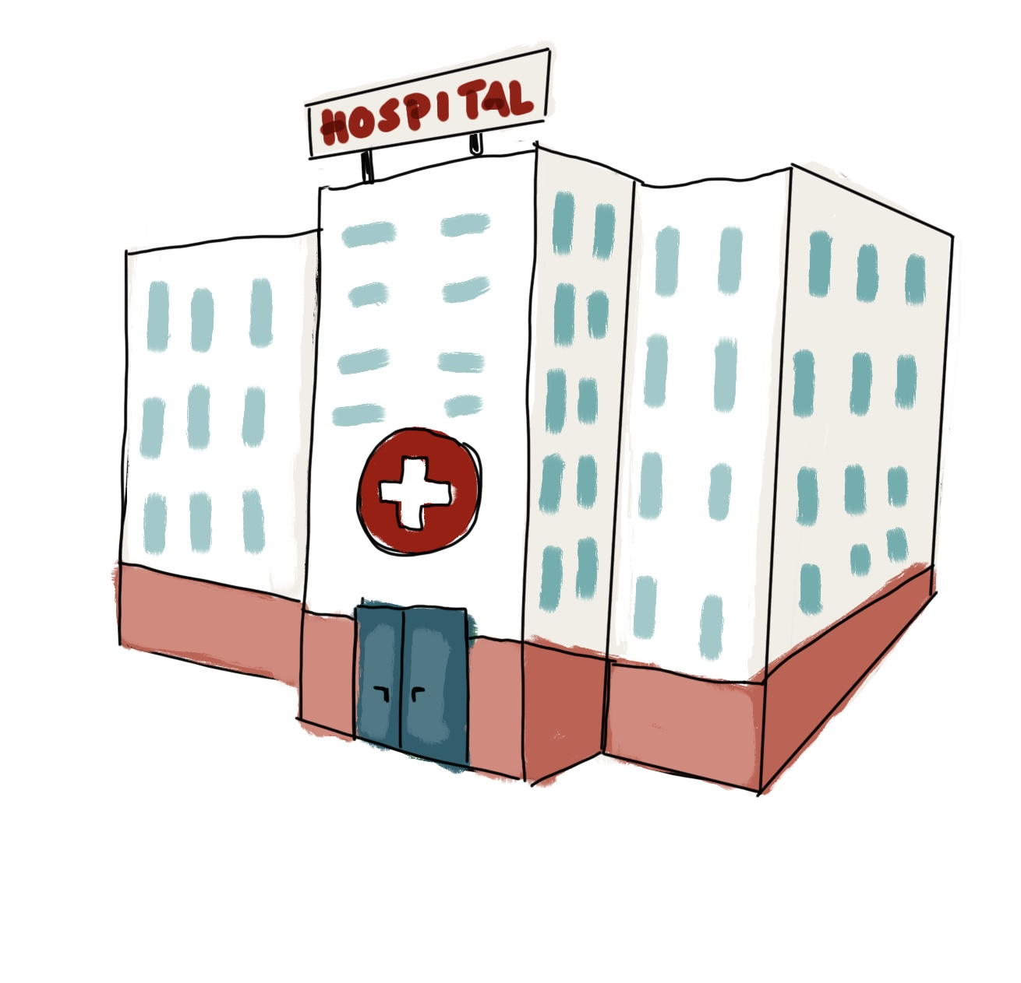
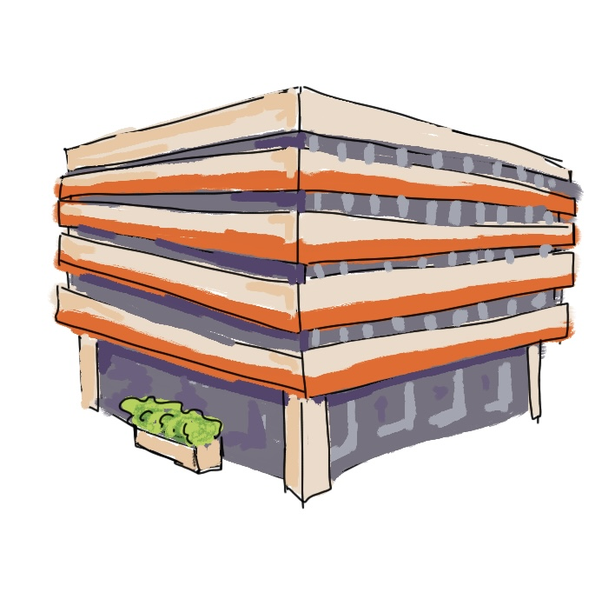

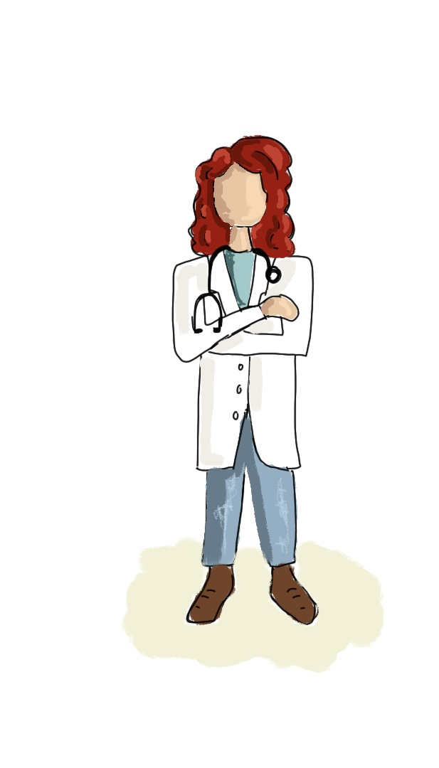
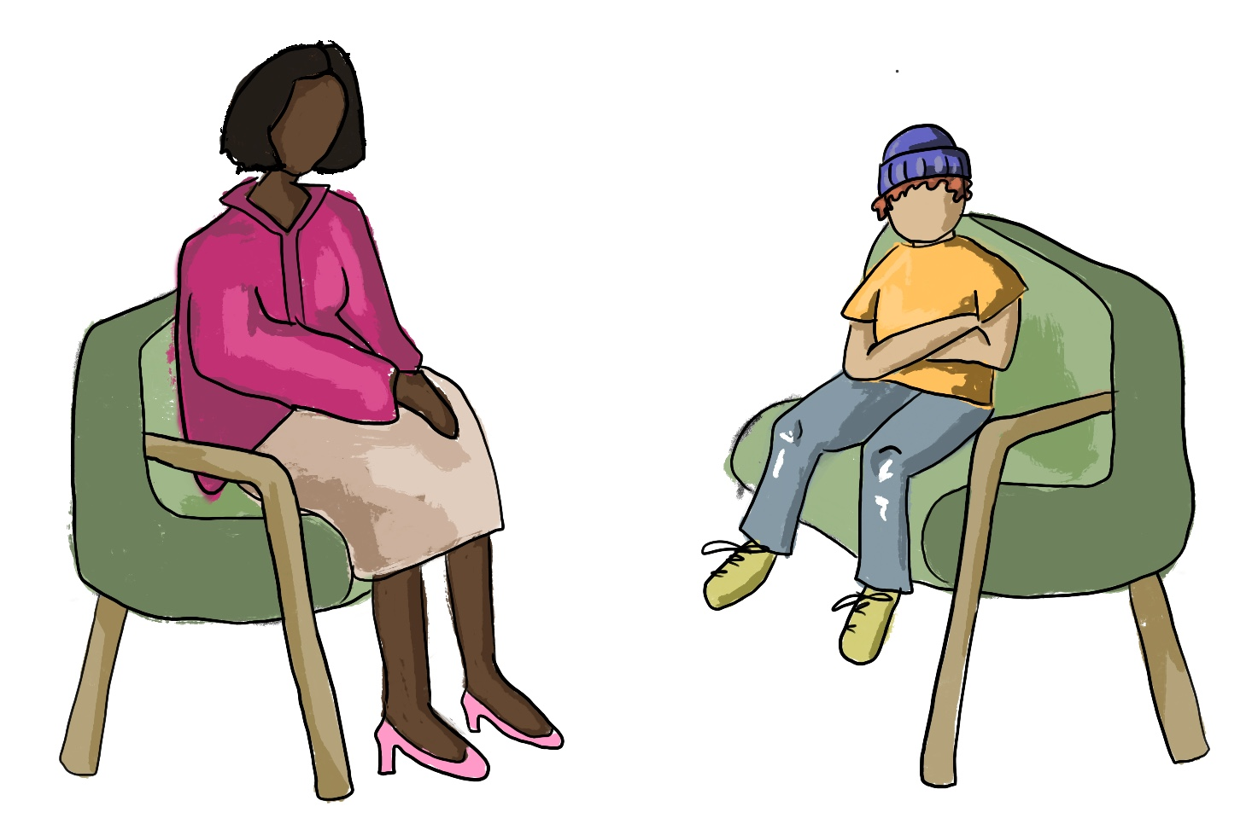


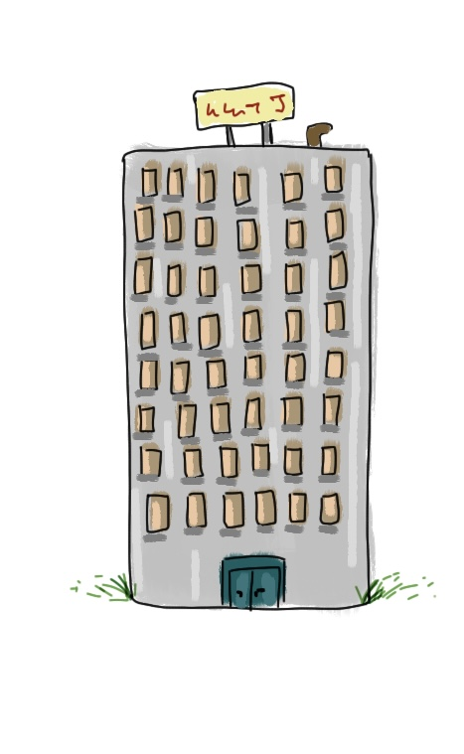


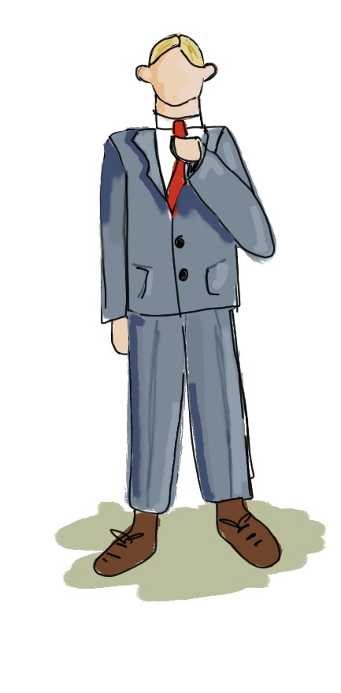

















Complex reality

Slide 3















Complex reality
Important values for society and individuals
Notes:
Access to affordable, safe and good services

Slide 4
Complex reality
Important values for society and individuals
Regulatory object
Notes:
Access to affordable, safe and good services

Slide 5
Complex reality
Important values for society and individuals
Compliance
Regulatory object
Notes:
Access to affordable, safe and good services

Slide 6
Complex reality
Important values for society and individuals
Compliance
Change
Regulatory object
Notes:
Access to affordable, safe and good services

Slide 7
Complex reality
Important values for society and individuals
Inspections can contribute to change
Compliance
Change
Regulatory object
Notes:
Access to affordable, safe and good services

Slide 8
Complex reality
Important values for society and individuals
However…
Not all change leads to improvement in delivery of care that benefits the patients
Compliance
Change
Regulatory object
Notes:
Access to affordable, safe and good services

Slide 9
Complex reality
Important values for society and individuals
How can regulators balance the need for innovation in the services with safeguarding patients rights and safety?
Compliance
Change
Regulatory object
Notes:
Access to affordable, safe and good services

Slide 10
